Slide 1
VIRTUAL PAINTER
Presented By: Rajeev (19/it22) & Sahil (19/it27)

Slide 2
INTRODUCTION
Most of the people are familiar with various painting software. In the digital social media where photos or images got much importance, the need of a user friendly painting software is essential. The traditional painting software require a hardware pointing devices or a touch sensitive screen for interaction. In most cases we need a hardware medium for interacting with the software system. Direct use of hands as an input device is an attractive method for providing natural human - computer interaction which has evolved from text based interfaces through graphical based interfaces.

Slide 3
TECHNOLOGY USED:
Language:-
This project will be developed in Python is a high-level, interpreted. Interactive and object-oriented scripting language. Python is designed to be highly readable. It uses English keywords frequently where as other languages use punctuation, and it has fewer syntactical constructions than other languages. It was mainly developed for emphasis on code readability, and its syntax allows programmers to express concepts in fewer lines of code.

Slide 4
Modules Needed:
OpenCV:- It is a huge open-source library for computer vision, machine learning, and image processing. OpenCV supports a wide variety of programming languages like Python, C++, Java, etc. It can process images and videos to identify objects, faces, or even the handwriting of a human. When it is integrated with various libraries, such as Numpy which is a highly optimized library for numerical operations. If not pre-installed then use command line :
pip install opencv-python.

Slide 5
Numpy :- It is a general-purpose array-processing package. It provides a high-performance multidimensional array object, and tools for working with these arrays. It is the fundamental package for scientific computing with Python. Besides its obvious scientific uses, Numpy can also be used as an efficient multi-dimensional container of generic data. To install it execute the following command in the command-line:
pip install numpy.

Slide 6
MediaPipe
:- It is most important part of this project Hand tracking is the process in which a computer uses computer vision to detect a hand from an input image and keeps focus on the hand’s movement and orientation. Hand tracking allows us to develop numerous programs that use hand movement and orientation as their input.We tend to write the same code in different projects to perform hand tracking as part of our program. Creating a hand tracking module solves this problem since we write the code once.We then convert this piece of code into a module. We can import this module into any python project that we are working on and it will perform hand tracking.

Slide 7
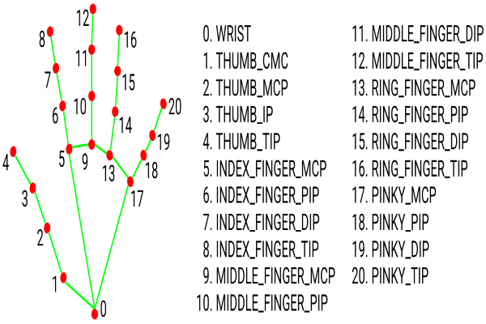

Slide 8
SOFTWARE AND HARDWARE REQUIREMENTS
Software Requirements:
OS: Windows
IDE: Visual Studio Code
Language: Python
Particular GUI Library: Tkinter
Hardware Components:
Processor - Dual Core
Hard Disk – 500GB
Memory - 4GB RAM
Mouse - Any Standard
Keyboard - Any Standard
Monitor -Any color monitor

Slide 9
OBJECTIVE AND SCOPE
1. Saves time and efforts.
2. Convenient to use.
3. Doesn’t required much knowledge of painting software.
4. Good accuracy.
5. Anyone can use it easily.

Slide 10
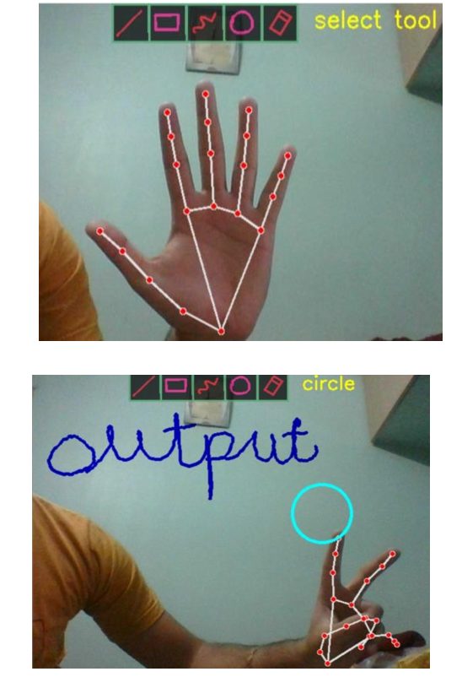

Slide 11
REFRENCES
GeeksforGeeks: For modules to be used in the project.

Slide 12


